Slide 1

“AS A FAMILY WE LIVE, LOVE, LEARN AND CELEBRATE WITH JESUS.”
Welcome to Year 4
Teacher: Miss Pickering and Mrs DiGiulio (Wednesday)
Teaching Assistant: Mrs Oudnie and Mrs Jewell

Slide 2
About me…
I am really looking forward to working with your children this year and getting to know all of you too!
This is my second year at the Holy Family school. I taught year 4 last year too so I know the curriculum really well and the expectations of learning outcomes for this age group.

Slide 3
Year 4 is important because…
A year for the children to become more independent and confident in their personal and academic development. This includes things such as all starting on a handwriting pen, being given more responsibility in the school daily tasks and further challenge in their academic studies.
A year for the children to develop their student voice.

Slide 4
Behaviour
As parents you have made a positive choice in sending your child to The Holy Family School. Our commitment is to promote excellent behaviour and behaviour for learning. For this to happen we ask that you are involved in your child’s school life and are supportive of our school ethos and behaviour policy . Our behaviour policy is an inclusive and restorative policy. We listen to our children and in cases of poor behaviour allow them to find ways to rectify this.
Our behaviour policy can be found on our school website.
Our Home School Agreement can be found on our school website
Please ensure you read this document carefully. By choosing to send your child to our school you are agreeing to uphold the commitments in this agreement.

Slide 5
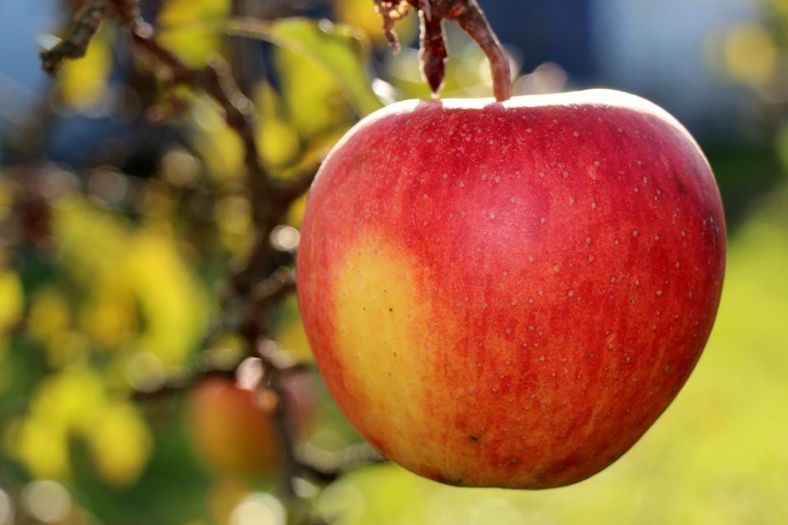


Our 5 values that the children have chosen
Trust
Family
Sharing
Acceptance
Honesty
This Photo by Unknown Author is licensed under CC BY-SA-NC

Slide 6

Attendance & punctuality
Good attendance at school is vital and is directly linked to academic success.
School gates open at 8.45am and close promptly at 9am. Arrival after this should be via the school office. Arrivals later than 9.15am will be marked as unauthorised absence.
Should your child be unable to attend school due to illness you must inform the school office by 9.30am. After this time the school office will phone to find out the reason for absence. If we are unable to make contact by 10.30am a member of the senior leadership team may make a home visit for safeguarding purposes.
Leave of absence – holidays should not be taken during term time and cannot be authorised. In exceptional circumstances some absences may be authorised at the discretion of the head teacher.
School finishes at 3.15pm, please ensure you are on time to collect your child. If you are going to be late please let the office know.
At 3.25pm children who have not been collected will go to the school office. Children who have not been collected by 3.30pm will attend afterschool club and there may be a charge.

Slide 7
Classroom house keeping
If children are bringing in packed lunches, they should be healthy and nutritious.
Snacks at break time should be fruit/vegetables only.
Our school lunches our nut and allergy free.
Smart watches are not allowed in school.
Hair should be tied up.
Children should have water bottles everyday and weather appropriate clothing e.g. hats, suncream (pre-applied at home), gloves, etc.

Slide 8
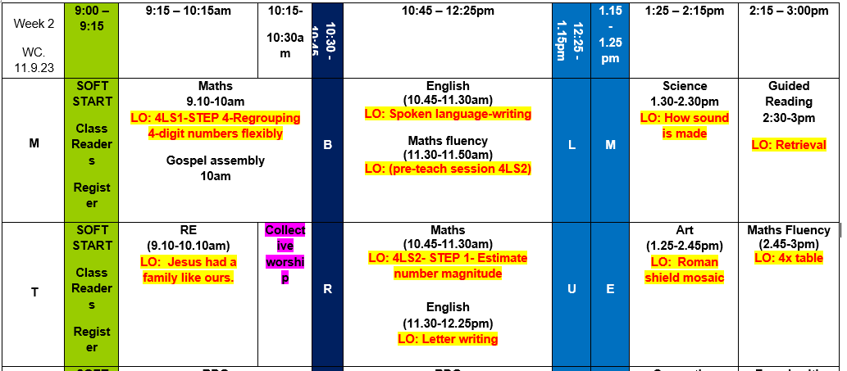
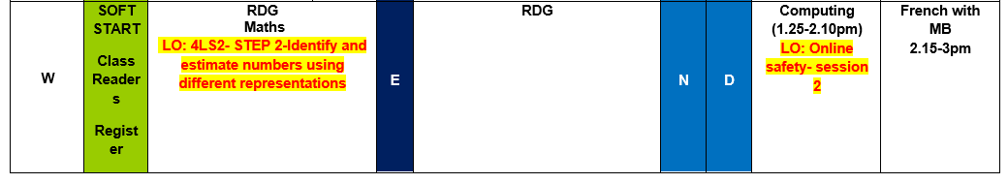
Classroom Timetable

Slide 9
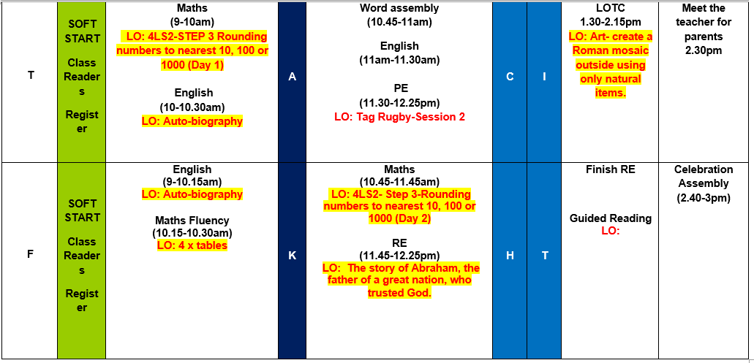
Classroom Timetable

Slide 10
Year 4 Curriculum
You can access the year 4 long term plan (LTP) on our class page to see the teaching that will take place across the year. In addition, the curriculum newsletter per term will be uploaded on to the website. I will show you our curriculum plan for this term.
https://www.holyfamily.herts.sch.uk/

Slide 11
How we Teach English/reading
In English, we will be taking part in a whole school project looking at the book “Coming to England” which is a new text for this year. Once the project is complete we will start our first year 4 topic which is “Roman Myths” where the children will ultimately write their own myth.
We will be looking at different texts related to our History topic also, our first class novel is “Romans on the Rampage” by Jeremy Strong which we are also using as our guided reading text.
As the class reads, we will use the text to explore vocabulary, language, imagery and literary techniques. We look at the grammar used and they will use this as a prompt for their own creative writing later on.
Children will be given opportunities to write texts similar to those they have read and where possible be given writing tasks for real purposes e.g. writing to an author, provide information for children in another class.
They will be given opportunities to generate ideas for their writing and create a plan.
They will then draft and write sentences for their piece by rehearsing them aloud.
They will organise paragraphs around a topic or theme.
In narratives they will create settings, characters and plot.
In non-fiction they will be expected to use organisational devices such as sub-headings and a clear introduction.
The children will be taught to evaluate and edit their writing and given opportunities to read their work aloud in class.

Slide 12
How we Teach Maths
Number & Place Value
count in multiples of 6, 7, 9, 25 and 1,000
find 1,000 more or less than a given number
count backwards through 0 to include negative numbers
recognise the place value of each digit in a four-digit number round any number to the nearest 10, 100 or 1,000
read Roman numerals to 100 (I to C)
Addition & Subtraction
add and subtract numbers with up to 4 digits using the formal written methods of columnar addition and subtraction where appropriate
Multiplication & Division
recall multiplication and division facts for multiplication tables up to 12 × 12, recognise and use factor pairs
multiply two-digit and three-digit numbers
solve problems involving multiplying and adding,
Fractions
add and subtract fractions with the same denominator
recognise and write decimal equivalents to ¼; ½; ¾

Slide 13
How can you help your child?
Listen to your child read every day.
Discussions at home about what the children have learnt at school and make reading part of your daily discussions. (This is going to be a big focus for us this year as part of our Oracy project).
Read to your child as often as you can! This can include magazines and newspapers (age appropriate), signposts, recipes!
Please record any/all reading on Boom Readers.
Times table check (MTC) at the end of the year. Practising!

Slide 14
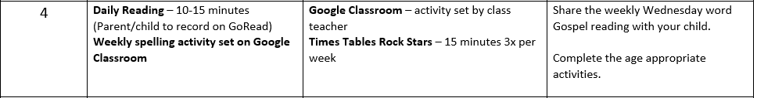
Home learning Expectations
Any problems with logging in on Boom Reader, TTRS, Purple Mash or Google Classroom should be reported immediately to the office to rectify the situation. We will not automatically know there is a problem. Failure to do so will mean your child is missing out on accessing platforms they need to complete their work.

Slide 15
Mass and Class Masses
We will hold a whole school Mass at least once each term, the whole school community are invited.
There will be a class Mass for each year group across the year, parents and family are invited to attend.

Slide 16
Sports/Outdoor learning
Our PE day this term will be Thursday.
This term the children will have Tag Rugby.
Earrings must be taken out prior to the lesson, otherwise your child cannot take part in the activities.
Children need to wear their PE kit into school, dark (Black) joggers (no brands)
Plain black hoodie
Trainers (black)
Raincoat
Wellies – can be left in school.

Slide 17
Class trips
Class trips will be organised for year 4. As much notice as possible will be given to you all especially if any payment is requested.
We won’t be going swimming this year (Y5/Y6)

Slide 18


Communication
Twitter - @holyfamilyWGC
Facebook - TheHolyFamilySchoolWGC
Newsletters & News bulletins
Class page on website
Class email – year4@holyfamily.herts.sch.uk

Slide 19
Any Questions?

