Slide 1
“AS A FAMILY WE LIVE, LOVE, LEARN AND CELEBRATE WITH JESUS.” Welcome to Year 3
Teacher: Miss Fox
Teaching Assistant: Mrs Tamburello, Miss Oudnie and Miss Jewell

Slide 2
About me…
I’m 31 years old.
I have lived in WGC for most of my life, having grown up in central London.
I’m passionate about reading, and developing reading for pleasure.
I have taught in Year 2, and Reception.
Previously I was cabin crew for 8 years.

Slide 3
Year 3 is important because…
It is a new key stage
Children make their First Holy Communion
We learn new school routines
Children are on a new playground
Children continue to develop different maths strategies
Children begin to have more choice surrounding their reading, when they become free readers and usually have no more scheme books.
Children begin to learn a modern foreign language – French.

Slide 4
Behaviour
As parents you have made a positive choice in sending your child to The Holy Family School. Our commitment is to promote excellent behaviour and behaviour for learning. For this to happen we ask that you are involved in your child’s school life and are supportive of our school ethos and behaviour policy . Our behaviour policy is an inclusive and restorative policy. We listen to our children and in cases of poor behaviour allow them to find ways to rectify this.
Our behaviour policy can be found on our school website.
Our Home School Agreement can be found on our school website
Please ensure you read this document carefully. By choosing to send your child to our school you are agreeing to uphold the commitments in this agreement.

Slide 5
Attendance & punctuality
Good attendance at school is vital and is directly linked to academic success.
School gates open at 8.45am and close promptly at 9am. Arrival after this should be via the school office. Arrivals later than 9.15am will be marked as unauthorised absence.
Should your child be unable to attend school due to illness you must inform the school office by 9.30am. After this time the school office will phone to find out the reason for absence. If we are unable to make contact by 10.30am a member of the senior leadership team may make a home visit for safeguarding purposes.
Leave of absence – holidays should not be taken during term time and cannot be authorised. In exceptional circumstances some absences may be authorised at the discretion of the head teacher.
School finishes at 3.15pm, please ensure you are on time to collect your child. If you are going to be late please let the office know.
At 3.25pm children who have not been collected will go to the school office. Children who have not been collected by 3.30pm will attend afterschool club and there may be a charge.

Slide 6
Uniform
Children should be coming to school dressed in the correct uniform.
This includes:
Appropriate hairstyles (sensible hair accessories, .i.e. red).
Children are not allowed smartwatches at school.
As we approach the cooler months the children should be coming in with appropriate clothing .i.e. coats, scarves, gloves.
They will need wellie boots for outdoor learning.
PE kits:
Jogging bottoms
White top
Plain black sweatshirt.

Slide 7
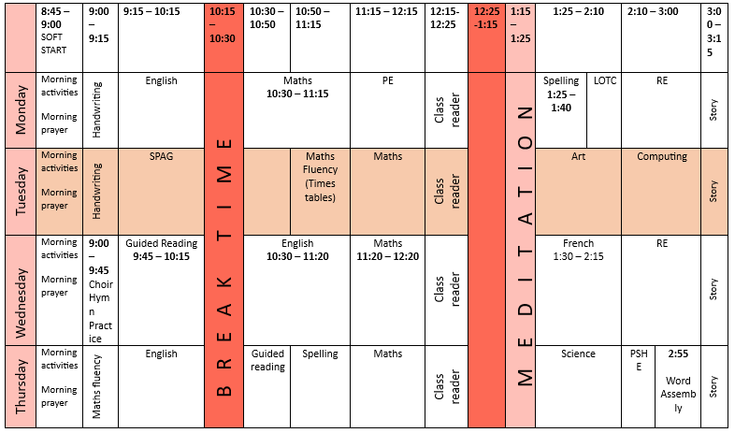
Class Timetable

Slide 8
Year 3 Curriculum
Autumn 1 – Stone Age
Autumn 2 – Climate and Weather
Spring 1 – Bronze Age to Iron age
Spring 2 – Marvelous Maps (Our world)
Summer 1 – Eeery Egyptians (Egyptian Workshop)
Summer 2 - Coasts

Slide 9
How we Teach English/reading
Every child will read with us each week during guided reading sessions and heard individually.
Children will undertake daily English lessons supported by the Herts for Learning scheme of work which is mapped to all areas of the National curriculum English objectives.

Slide 10
How we Teach Phonics/spelling
Phonics and Spelling will be incorporated into day-today teaching. Some children will continue to receive support through discrete small group sessions.
Spelling is taught using ESSENTIAL Spelling.

Slide 11
How we Teach Maths
Areas in the curriculum
Number – number and place value
Number – addition and subtraction
Number – multiplication and division
Number – fractions
Measurement
Geometry
Statistics

Slide 12
How can you help your child?
Ensure you read with them every day if you can and ask them questions about what they have read to help develop their comprehension. Don’t be afraid to read a book with them that they might find a bit of a challenge.
Ensure they have everything they need with them each day.
Encourage your child to use TTRS daily and to complete their homework weekly.

Slide 13
Home learning Expectations
English
Daily Reading – 10-15 minutes (Parents to record on GoRead)
Purple Mash spelling activity set on Google Classroom
Maths
Purple Mash activity set on Google Classroom
Times Tables Rock Stars – 15 minutes 3xper week
RE
Share the weekly Wednesday word Gospel reading with your child.
Complete the age appropriate activities.

Slide 14
Mass and Class Masses
We will hold a whole school Mass at least once each term, the whole school community are invited.
There will be a class Mass for each year group across the year, parents and family are invited to attend.

Slide 15
Sports/Outdoor learning
PE and Outdoor learning will take place every Monday.
Your child needs to come into school in their PE kit which should be suitable to keep them protected against all weathers.
If it is raining please make sure your child brings a waterproof jacket to school and that they also have wellington boots in school.

Slide 16
Communication
Twitter - @holyfamilyWGC
Facebook - TheHolyFamilySchoolWGC
Newsletters & News bulletins
Class page on website
Class email – year3@holyfamily.herts.sch.uk

Slide 17
Any Questions?

