Slide 1
Welcome to Boomreader!

Slide 2
“If you are going to get anywhere in life you have to read a lot of books.”
– Roald Dahl

Slide 3
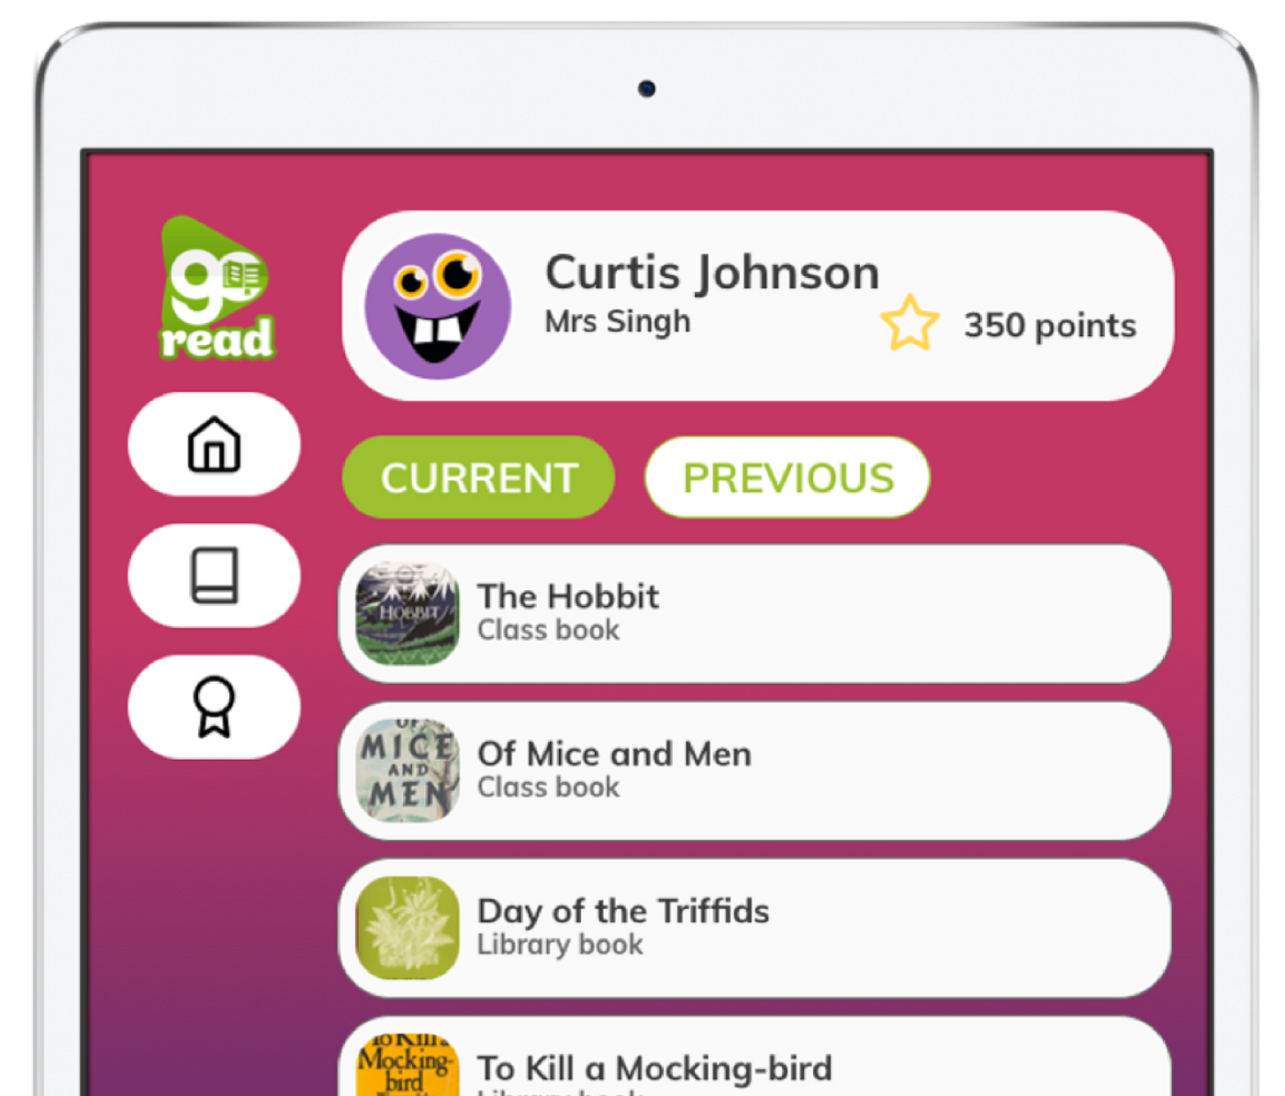
What is Boomreader?
Boomreader is a digital reading record where you can log your reading and earn gems!
You can log your reading really quickly and easily
You can write a review of what you have read
You can create your own avatar and use your gems to buy reward cards.

Slide 4
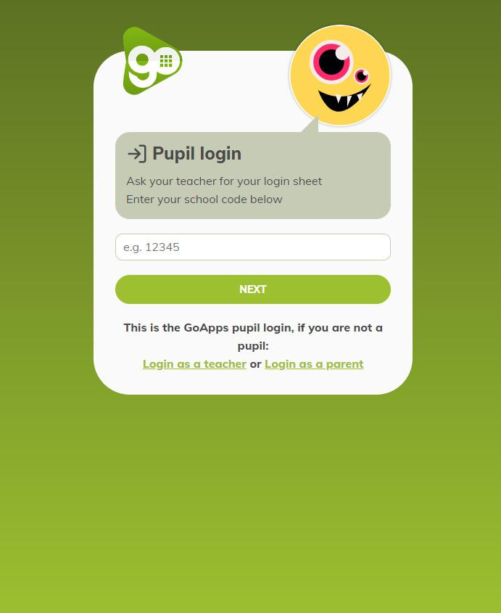
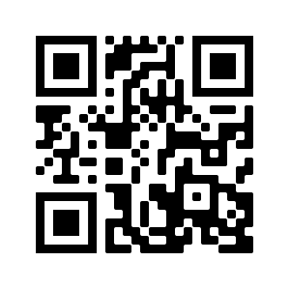
Getting started
Go to: pupils.boomhub.app
Put your school code in
Then put your pupil login code in- this is your code- don’t share it!

Slide 5
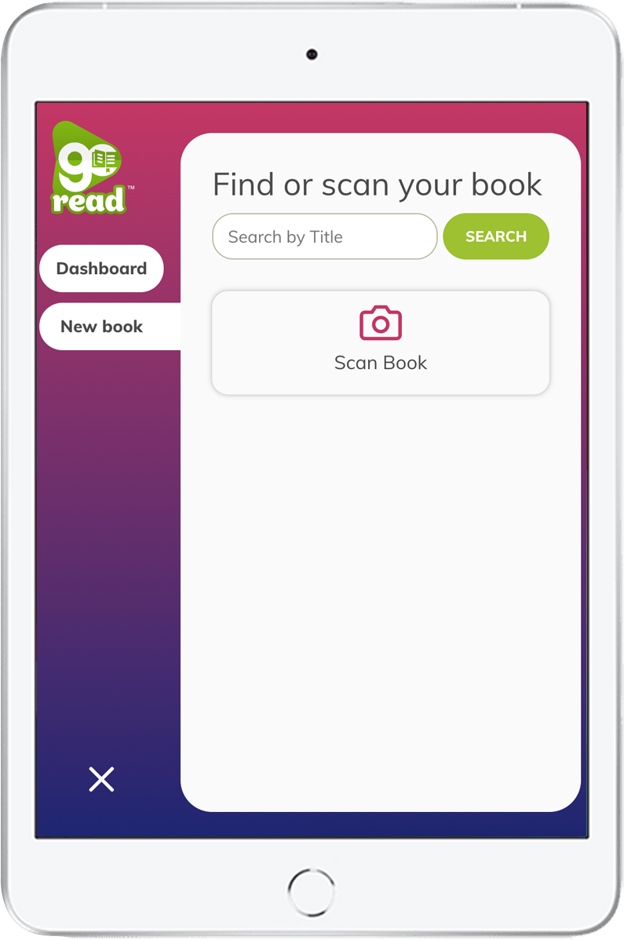
Adding books
Click on Boomreader
Click the + button
You can add a book by scanning it, searching for it or writing in the title and author yourself

Slide 6
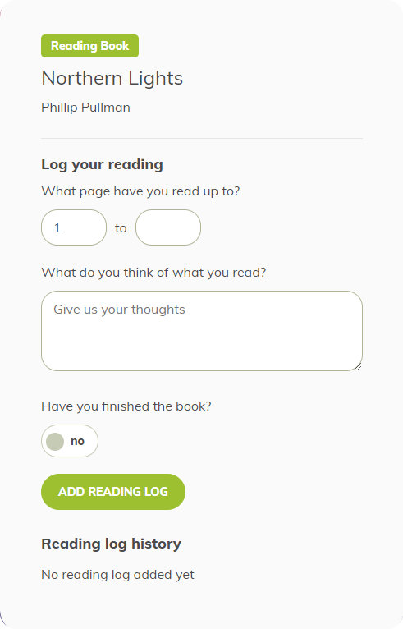
Logging reading
Click on a book to log reading
Log the page number you reach
Then you have the chance to share your thoughts:
What has happened so far in your book?
What do you think might happen next?
What have you learned so far?
What new words have you discovered?

Slide 7
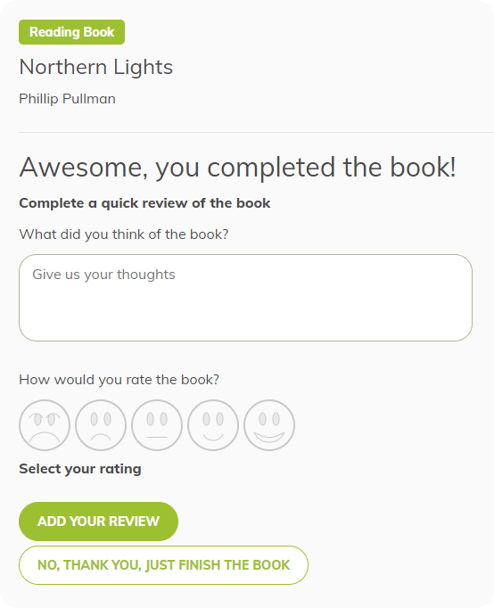
Book reviews
When you finish a book- make sure you click the book completion button
It will then give you the chance to write a book review and give it a star rating!
In your review:
Try and be as honest as possible. Summarise the book and perhaps offer a recommendation for others

Slide 8
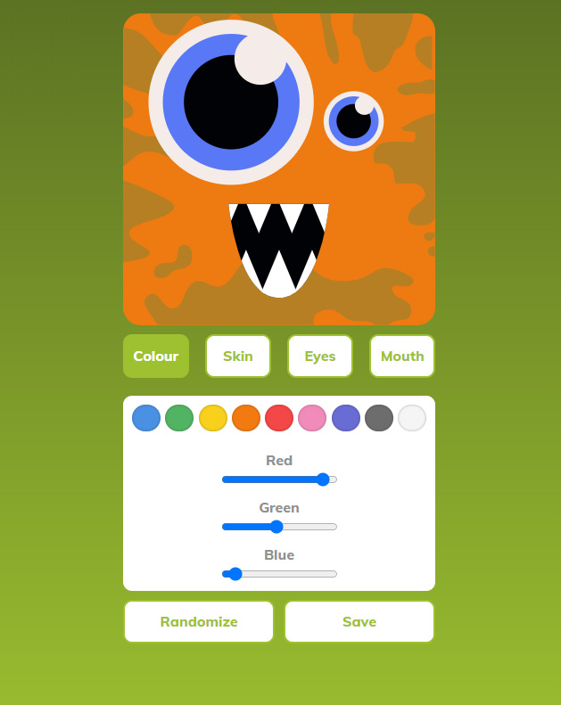
Avatars & gems!
You can create a weird and wonderful avatar - go wild!
You earn gems for logging reading (up to twice per day). The amount of gems you earn is randomised between 1-3 each time. How many will you get?

Slide 9
Now you know what to do…

Slide 10
“You can find magic wherever you look. Sit back and relax all you need is a book!”
– Dr. Seuss

