Slide 1

“AS A FAMILY WE LIVE, LOVE, LEARN AND CELEBRATE WITH JESUS.”
Welcome to Year 5
Teacher: Miss Clifford and Mrs DiGiulio (Monday)
Teaching Assistants: Mrs McNulty

Slide 2
About me…
I have been teaching for 22 years in schools in London.
Family originally from Ireland.
Relocated to Hertford 3 years ago and joined the Holy Family.
Degree in music and enjoy singing and amdram!

Slide 3
Year 5 is important because…
It is a year where we embed all the knowledge learnt in lower keys stage.
This is often a year when children grow in maturity, they gain a greater independence and confidence from being given more responsibility in their learning.
Children in Year 5 are increasingly encouraged to take responsibility for their own learning: being ready for the lessons, do their homework, to pack their school bag, to remember their PE kits. And they develop and grow as a result. It is about encouraging independence in preparation for bigger things to come.

Slide 4
Behaviour
As parents you have made a positive choice in sending your child to The Holy Family School. Our commitment is to promote excellent behaviour and behaviour for learning. For this to happen we ask that you are involved in your child’s school life and are supportive of our school ethos and behaviour policy . Our behaviour policy is an inclusive and restorative policy. We listen to our children and in cases of poor behaviour allow them to find ways to rectify this.
Our behaviour policy can be found on our school website.
Our Home School Agreement can be found on our school website
Please ensure you read this document carefully. By choosing to send your child to our school you are agreeing to uphold the commitments in this agreement.

Slide 5

Attendance & punctuality
Good attendance at school is vital, particularly after the last 18 months of disrupted schooling and is directly linked to academic success.
School gates open at 8.45am and close promptly at 9am. Arrival after this should be via the school office. Arrivals later than 9.15am will be marked as unauthorised absence.
Should your child be unable to attend school due to illness you must inform the school office by 9.30am. After this time the school office will phone to find out the reason for absence. If we are unable to make contact by 10.30am a member of the senior leadership team may make a home visit for safeguarding purposes.
Leave of absence – holidays should not be taken during term time and cannot be authorised. In exceptional circumstances some absences may be authorised at the discretion of the head teacher.
School finishes at 3.15pm, please ensure you are on time to collect your child. If you are going to be late please let the office know.
At 3.25pm children who have not been collected will go to the school office. Children who have not been collected by 3.30pm will attend afterschool club and there may be a charge.

Slide 6
Classroom routines
English and Maths daily lessons;
Meditation after lunch;
PE and LOTC on a Wednesday
Swimming on Monday for autumn term.
Music on a Wednesday – led by Mrs Kee

Slide 7
Year 5 Curriculum topics
AUTUMN 1
Explorers – Geography focus – Journeys- Trade -Where does all our stuff come from?
AUTUMN 2
Explorers - Geography focus - Rivers and the Water Cycle - How does the water go round and round?

Slide 8
Year 5 Curriculum topics
SPRING 1
Anglo Saxons – History focus – Anglo Saxons - Was the Anglo-Saxon period really a Dark Age?
SPRING 2
Vicious Vikings - History focus – Vikings - Would the Vikings do anything for money?

Slide 9
Year 5 Curriculum topics
SUMMER 1
Ancient Greece – History focus – What did the Greeks do for us?
SUMMER 2
Marvellous Mountains - Geography focus – Mountains - EUROPE – A STUDY OF THE ALPINE REGION: Where should we go on holiday?

Slide 10
RE Curriculum – Come and See
Focus for this term is:
Ourselves
Life Choices
Judaism
Hope
Wednesday word tasks

Slide 11
How we Teach English/reading
Whole class guided reading sessions focus on comprehension skills.
Children read quietly every day at school.
Some children will continue to receive intervention in a small groups with Mrs McNulty and Mrs Mc Dermott.

Slide 12








How we Teach English/reading

Slide 13
How we Teach English/reading
Whole class guided reading sessions focus on comprehension skills.
Children read quietly every day at school.
Some children will continue to receive intervention in a small groups with Mrs DiGuilo and Mrs Mc Dermott.

Slide 14
How we Teach Phonics/spelling
Phonics will be incorporated into day-to-day teaching.
Spelling is taught using ESSENTIAL spelling – list will be set up weekly on Google Classroom with a task to complete.

Slide 15
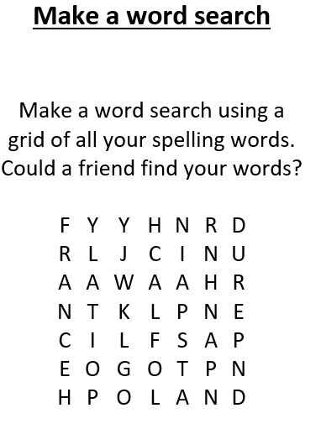


Spelling booklet
A list of spelling and a task will be set weekly for homework, children will be asked to complete a task from the spelling booklet to complete.

Slide 16
How we Teach Maths
Areas in the curriculum
Number – number and place value
Number – addition and subtraction
Number – multiplication and division
Number – fractions
Measurement
Geometry
Statistics

Slide 17
How can you help your child?
Continue to support your child at home by reading with them daily and discussing the book with them – use GoRead to record.
Practicing their timetables on Rockstars.
Purple Mash activities set related to topic.
Read Wednesday Word as a family and discuss the tasks.

Slide 18




Home learning Expectations
Daily Reading – 20 minutes (Child to record on GoRead)
Weekly spelling activity set on Google Classroom
Google Classroom – activity set by class teacher
Times Tables Rock Stars – 20 minutes 3x per week
Share the weekly Wednesday word Gospel reading with your child. Complete the age-appropriate activities. Use the discussion questions to talk about the Gospel reading.

Slide 19
Mass and Class Masses
We will begin this year by holding Mass in school for the children only.
We hope to progress to whole school Masses and class Masses where we invite our parents and wider community to attend.
We will update our school community on this through the next term.

Slide 20
Sports/Outdoor learning
PE and LOTC will be on Wednesday;
Children need to wear their PE kit into school, dark (Black or navy) joggers (no brands)
School sweatshirt or cardigan
Trainers (black if possible)
Raincoat
Wellies – can be left in school.

Slide 21
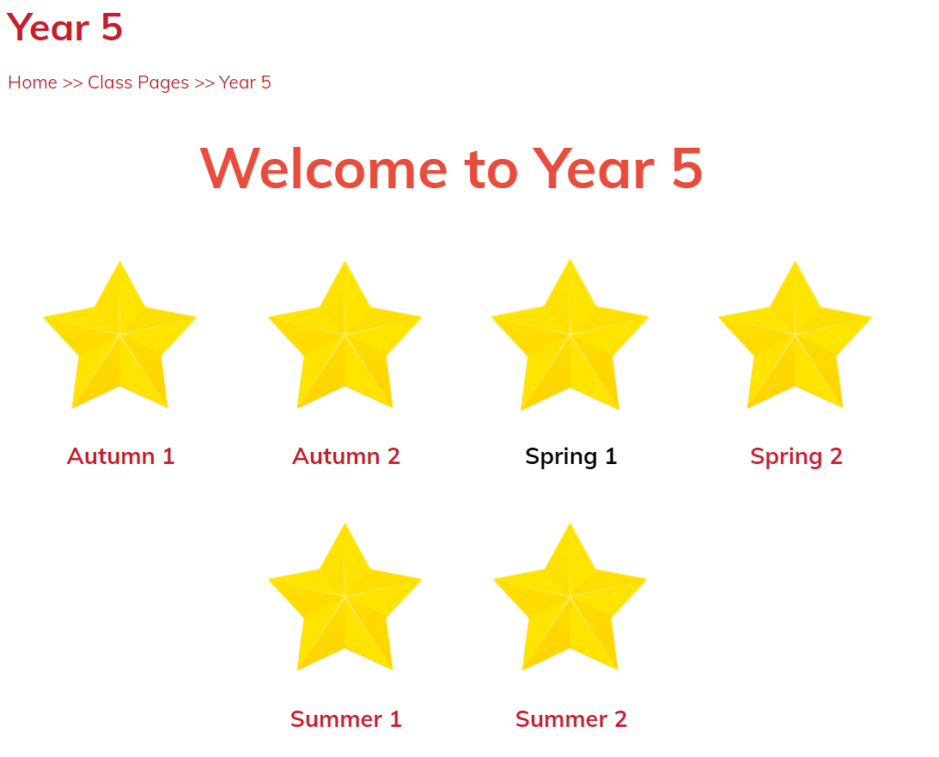
Our class page…
Will be updated by me at different points throughout the year (at least once every half term) with photographs, letters and information.

Slide 22


Connecting ….
Twitter is updated regularly with different information, please follow us.
Facebook – Holy Family page
Year 5 email – Year5@holyfamily.herts.sch.uk

Slide 23
Any Questions?

