Slide 1


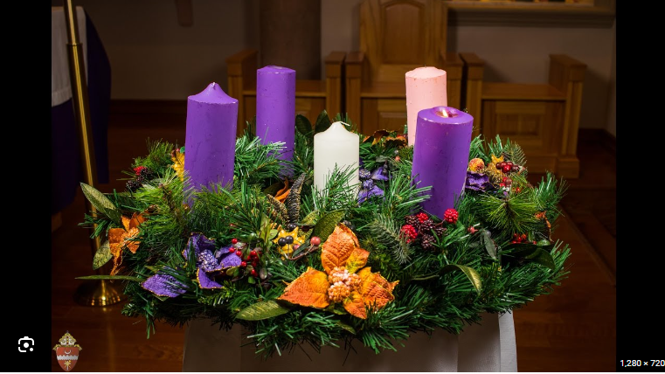
RE KNOWLEDGE ORGANISER
Year 2 – Loving-Preparing
ESSENTIAL VOCABULARY
Word | Definition
Preparing | Getting ready.
Advent | The time leading up to the coming of Jesus.
Christmas | Celebration of Jesus birth.
Nativity | The Birth of Jesus Christ.
Waiting | Allowing time to go by until an event is going to happen.
Annunciation | Angel Gabriel tell Mary about the coming of Jesus.
Visitation | Mary visiting her cousin Elizabeth.
ADVENT/CHRISTMAS – LOVING: PREPARING
Advent – Preparing for Christmas.
RE CURRICULUM DIRECTORY
Area of Study 1: Knowing and loving God, the Scriptures, Jesus Christ, Son of God Area of Study 2: What is the Church? One and holy
Key question:
Do we need to prepare?
Scripture:
Genesis 1: 3, 9, 20, 24-26 God’s Story 2 pages 8-9 Psalm 8: 3-11 – God’s Story 2 pages 28-29 Psalm 139: 14-18 – God’s Story 2 page 37 (teachers’ notes page 96) Psalm 19: 1-5 – God’s Story 2 pages 28-29
Reveal
Advent is four weeks of preparation for the celebration of the birth of Jesus at Christmas.
LINKS TO PREVIOUS LEARNING
EYFS –Birthday Year 1– Waiting
‘As a family we live, love, learn and celebrate with Jesus.’

