Slide 1


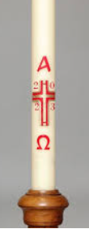
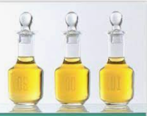
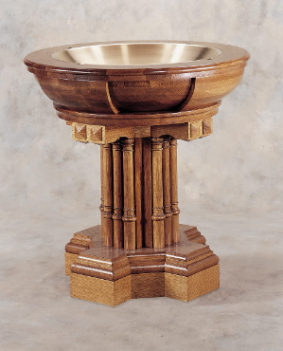
RE KNOWLEDGE ORGANISER
Year 2 – Baptism – Belonging- Signs and Symbols
ESSENTIAL VOCABULARY
Word | Definition
Garment | A piece of clothing.
Easter Candle | Paschal Candle used in Catholic churches to help remember Jesus Resurrection.
Font | Where Holy water is stored before a Baptism.
Chrism | Special oil used to make the sign of the cross.
Good News | Important information to tell others.
Symbols | A picture that represents something.
Baptism | When a baby is welcomed into the Church family.
Belonging | Feeling a part of something.
Baptism - Belonging
Come and see for yourself
RE CURRICULUM DIRECTORY
Area of Study 1: Knowing and loving God, the Scriptures, Creation, the Trinity, Jesus Christ, Son of God, the Holy Spirit Area of Study 2: What is the Church? Catholic Area of Study 3: Liturgy, Sacraments, Baptism, prayer
Key question:
Are signs and symbols important?
Reveal
Gods love and care for every family.
LINKS TO PREVIOUS LEARNING
EYFS –Myself Year 1– Families
‘As a family we live, love, learn and celebrate with Jesus.’

