Slide 1
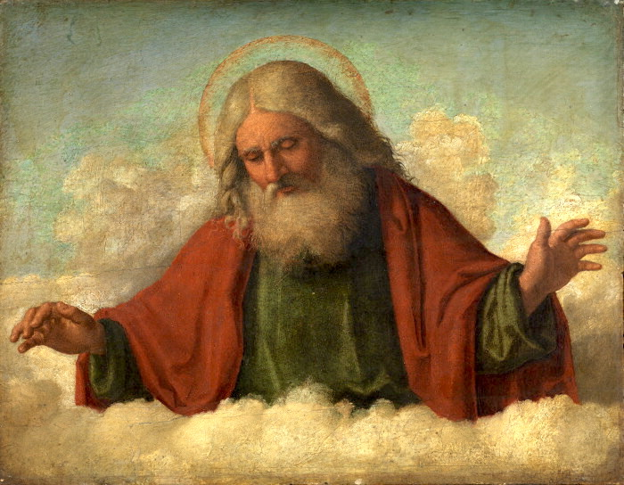
RE KNOWLEDGE ORGANISER
Year 2 – Beginnings
ESSENTIAL VOCABULARY
Word | Definition
Beginning | The first part of something or when it starts.
New start | The start of something new.
Family | Parents and their children, sometimes including grandchildren and other relations.
Friend | A person who you like or likes you.
Creation | The act of creating something.
Psalm | A religious song especially one from the Book of Psalms in the Bible.
Litany | A formal prayer with fixed responses.
Domestic Church-Family - Beginnings
God is present in every beginning.
RE CURRICULUM DIRECTORY
Area of Study 1: Knowing and loving God, the Scriptures, Creation, the Trinity, Jesus Christ, Son of God, the Holy Spirit Area of Study 2: What is the Church? One and holy, Catholic Area of Study 3: Prayer Area of Study 4: The dignity of the human person, the human community, love of God, love of neighbour
Key question:
What makes a place special?
Scripture:
Genesis 1: 3, 9, 20, 24-26 God’s Story 2 pages 8-9 Psalm 8: 3-11 – God’s Story 2 pages 28-29 Psalm 139: 14-18 – God’s Story 2 page 37 (teachers’ notes page 96) Psalm 19: 1-5 – God’s Story 2 pages 28-29
Reveal
God is present in every beginning.
LINKS TO PREVIOUS LEARNING
EYFS –Myself Year 1– Families
‘As a family we live, love, learn and celebrate with Jesus.’

