Slide 1
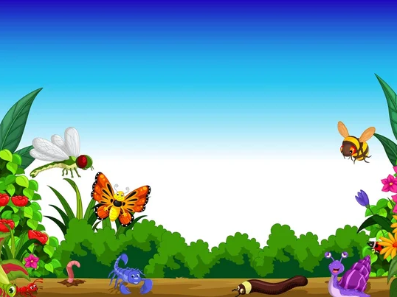
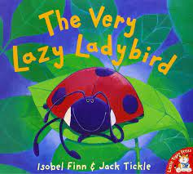
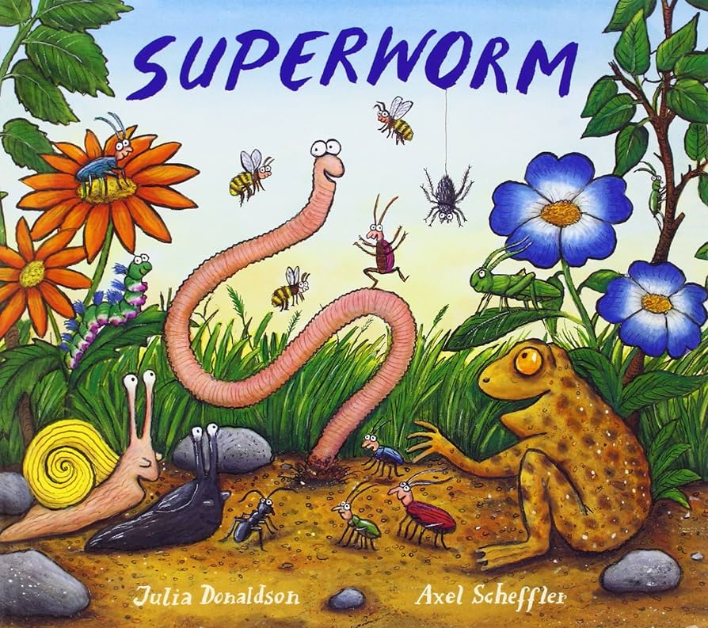
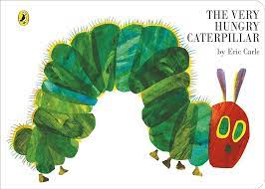
Marvellous Minibeasts
Nursery KNOWLEDGE ORGANISER
Summer 1
KEY VOCABULARY
Minibeast : small creatures', like worms, snails, insects and spiders. Lifecycle: a series of stages a living thing goes through during its life. . Cocoon: a shell made of silk that caterpillars make for themselves before they change into butterflies. Eco system: a system in nature where both plants and animals need one another to live.
TOPIC KNOWLEDGE
During our topic, the children will find out about different minibeasts that live in our outdoor area. They will have the opportunity to hunt for minibeasts and learn to recognise and describe them. To develop an understanding of the lifecycle of a butterfly the children will watch our own caterpillars transform into beautiful butterflies. Throughout the topic, the children will be increasing their awareness of the importance of minibeasts in our ecosystem and will build a bug hotel to support this.
KEY QUESTIONS
What is a minibeast? Where do minibeasts live? How do caterpillars change? Why do we need minibeasts?
KEY TEXTS
‘As a family we live, love, learn and celebrate with Jesus.’

