Slide 1




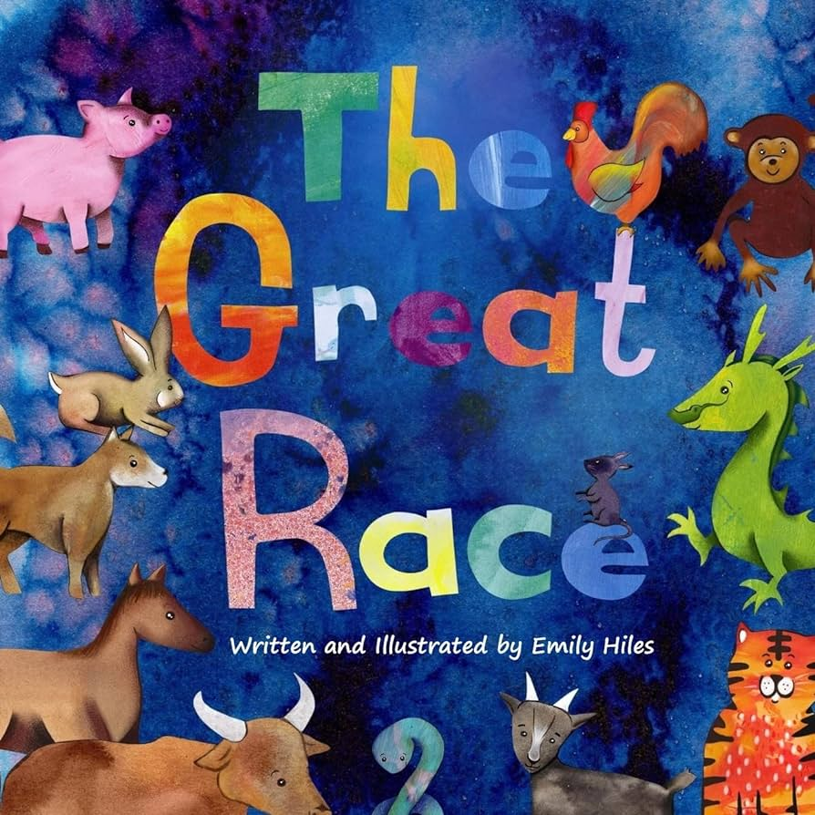

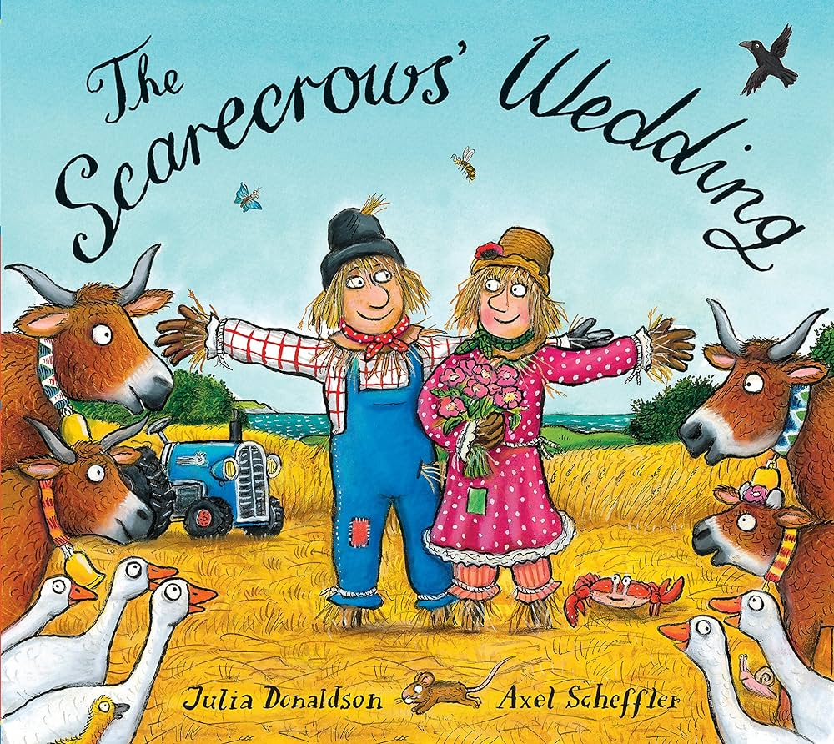
Celebrations
Nursery KNOWLEDGE ORGANISER
Spring 1
KEY VOCABULARY
Celebration: when you do something special for an important event or occasion. Birthday: the day you were born. Presents: a gift given on a special occasion. Decorations: put up on special occasions to make the room pretty. Invitations: asking people to come to the special occasion. Wedding: when 2 people get married. Chinese New Year: the celebration of new beginnings, happiness and joy. It is one of the most important festivals in Chinese culture. Shrove Tuesday: the traditional feast day before the start of Lent on Ash Wednesday. People eat pancakes ahead of their Lenten fasting. Ash Wednesday: the first day of Lent, it marks the first day when Christian people will make self-sacrifices or give things up until the beginning of Easter. Lent: Lent allows Christians to remember Jesus's fasting in the desert. It is a time of giving things up and a test of self-discipline.
TOPIC KNOWLEDGE
Children will find out about popular celebrations within their own families and will celebrate some key festivals and events together. Children will be able to share details of how their family celebrate and will find out about celebrations and traditions within other cultures around the world.
KEY QUESTIONS
What is a celebration? What do people celebrate? How do we celebrate? Why do we celebrate?
KEY TEXTS
‘As a family we live, love, learn and celebrate with Jesus.’

