Slide 1


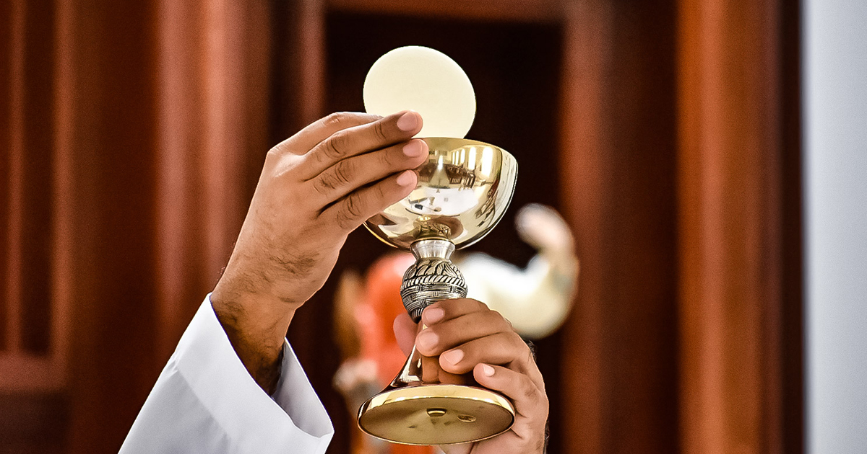
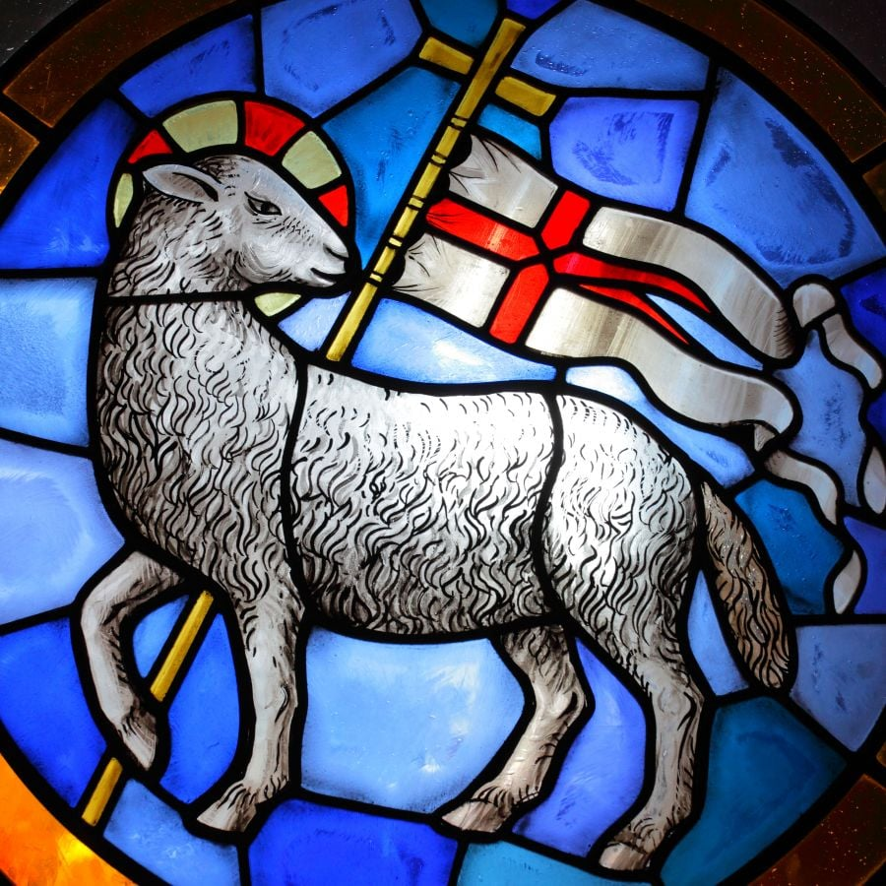
RE KNOWLEDGE ORGANISER
Year 4 – Topic 5- Eucharist/Giving and Receiving
ESSENTIAL VOCABULARY
Giving | all created things are gifts from God, given to be shared for the good of all..
Receiving | A person is said to be fully initiated in the Catholic Church when s/he has received the three sacraments of Christian initiation, Baptism, Confirmation and Eucharist.
Eucharist | Thanksgiving) because it is an action of thanksgiving to God.
The Lord’s supper | connection with the supper which the Lord took with his disciples on the eve of his Passion.
Breaking of the bread | Jesus used this rite, part of a Jewish meal, when as master of the table he blessed and distributed the bread, above all at the Last Supper. It is by this action that his disciples will recognise him after his Resurrection. The memorial of the Lord’s Passion and Resurrection.
Holy sacrifice | one sacrifice of Christ the Saviour and includes the Church’s offering.
Holy communion | by this sacrament we unite ourselves to Christ who makes us sharers in his Body and Blood to form a single body.
Sign of peace | Liturgical practice of giving a sign of peace, union, or friendship, as a handshake or embrace, at some point in a Christian service
Lamb of God | God gave Jesus to be killed like a lamb for our sins so we could live forever.
Liturgical/prayer links
The Eucharist The Introductory Rite Communion Rite
RE CURRICULUM DIRECTORY
Area of Study 1: Knowing and loving God, the Scriptures, the Trinity, Jesus Christ, Son of God Area of Study 2: What is the Church? One and holy, Catholic, Mission Area of Study 3: Liturgy, Sacraments, prayer Area of Study 4: The dignity of the human person, the human community, love of God, love of neighbour
Key questions:
Why is giving important as well as receiving? What are the joys and demands of giving and receiving? Why is giving and receiving important in any group? Why is it important to live in communion?
Scripture:
Matthew 5: 45-48 1 Corinthians 11: 24-27
Reveal
The Eucharist challenges and enables living and growing in communion.
LINKS TO PREVIOUS LEARNING
Year 3-listening & Sharing - Jesus gives himself to us.
‘As a family we live, love, learn and celebrate with Jesus.’

