Slide 1
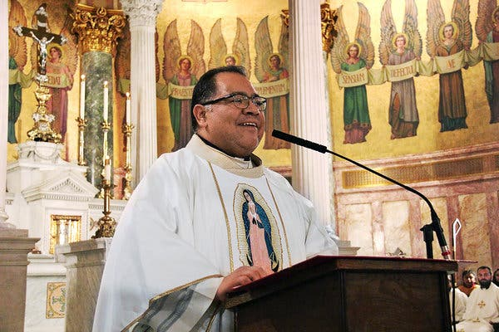
RE KNOWLEDGE ORGANISER
Year 4 – Topic 4- Community
ESSENTIAL VOCABULARY
Community | a group of people living in the same place or having a particular characteristic in common.
Commitment | the state or quality of being dedicated to a cause
Responsibility | he state or fact of having a duty to deal with something and being accountable.
Parish | a small administrative district typically having its own church and a priest or pastor.
Laity | the people of a religious faith who are not members of its clergy
Ministries | is the activity that is done by members of the church to serve the purposes of the church.
Extraordinary ministers | The person who, in case of necessity, is permitted or specially delegated to administer one of the sacraments.
Service | the action of helping or doing work for someone.
Funeral rites | rite of passage, which affects everyone involved–including the deceased.
Pastoral area | Lectors (Readers), Extraordinary Ministers of Holy Communion, Altar Servers, Choir and Musicians, Church Cleaners, Ushers, Welcomers.
Deanery | the group of parishes presided over by a rural dean.
Liturgical/prayer links
Funeral prayers, Eternal rest.
RE CURRICULUM DIRECTORY
Area of Study 1: Knowing and loving God, the Scriptures, the Trinity, Jesus Christ, Son of God Area of Study 2: What is the Church? One and holy, Catholic, Apostolic, Mission Area of Study 3: Liturgy, Sacraments, Holy Orders, prayer Area of Study 4: The dignity of the human person, the human community, the love of God and love of neighbour.
Key questions:
Why do people give up their time to help others in the community? What makes communities function well for the good of others?
Scripture:
Acts 6: 2-13; 7: 57-60 Romans 12: 8-11 Mark 3: 13-19
Reveal
The life of the local Christian community.
LINKS TO PREVIOUS LEARNING
Year 3 - Journeys - Christian family’s journey with Christ
‘As a family we live, love, learn and celebrate with Jesus.’

