Slide 1
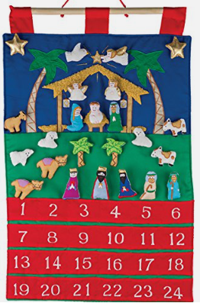
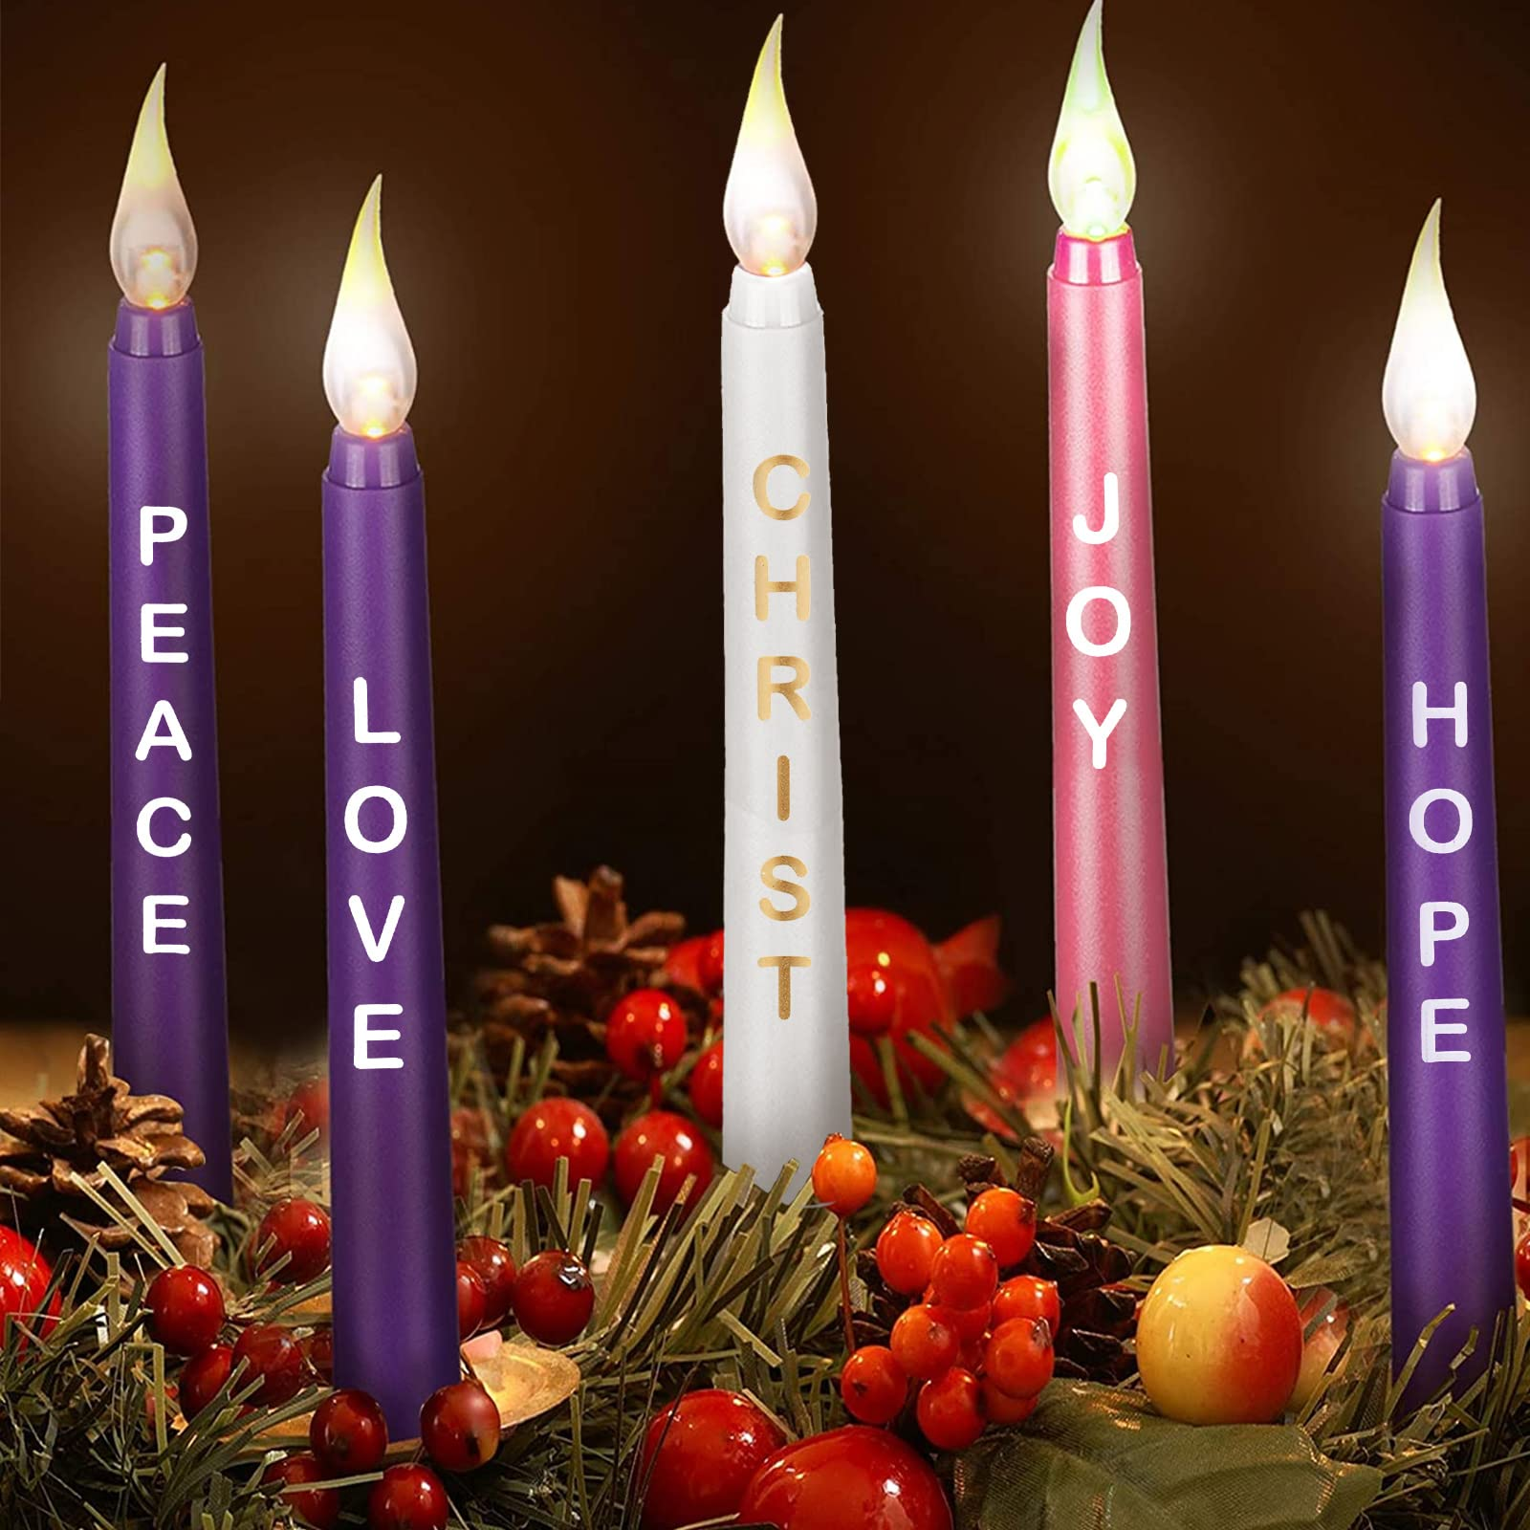
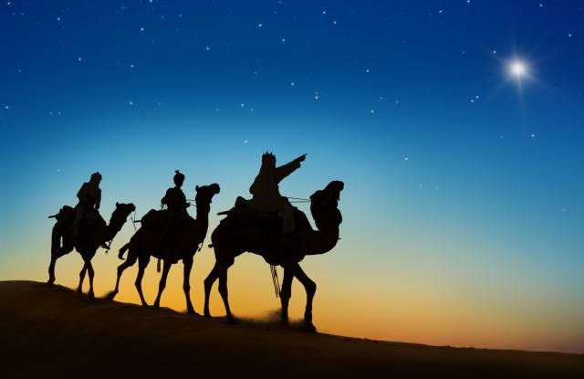
RE KNOWLEDGE ORGANISER
Year 4 – Advent/Christmas- Loving
ESSENTIAL VOCABULARY
Gift | Not necessarily a physical gift but the gift of love, friendship, patience and so on.
Friendship | a relationship between friends.
Loyalty | a strong feeling of support or allegiance.
Commitment | an engagement or obligation that restricts freedom of action.
Rejoice | feel or show great joy or delight. .
Peace | freedom from disturbance; tranquillity.
God’s plan | the Will of God
RE CURRICULUM DIRECTORY
Area of Study 1: Knowing and loving God, the Scriptures, the Trinity, Jesus Christ, Son of God, the Holy Spirit Area of Study 2: What is the Church? One and holy, Catholic Area of Study 3: Liturgy, prayer Area of Study 4: The dignity of the human person,
Church teachings:
This is an outline of the teaching of the Church covered in GIFT: The liturgical season of Advent. Advent is focused on the coming of Jesus as Messiah. Gaudete Sunday. The Messiah is the one promised by God who would show God’s love and bring peace. Isaiah’s prophecy about coming of the Messiah. Further understanding of the Incarnation. The visit of the Wise Men.
An Advent prayer
Give us the grace and strength we need every day. Help us to always trust in you. Come, Lord Jesus, lead all people closer to you. Come and dispel the darkness of our world with the light of your love.
Reveal
Advent and Christmas: the Church’s seasons of preparing to receive God’s gift of love and friendship in Jesus
LINKS TO PREVIOUS LEARNING
Year 3 - Visitors– How are visitors welcomed? The joys and demands of visitors
Scripture:
Isaiah 40: 9-11 Matthew 2: 1-12, 16-18 Ephesians 1: 3-6 1 John 4: 4, 9-12
Key questions:
Why are the gifts of love and friendship important? What are the joys and demands of the commitment?
‘As a family we live, love, learn and celebrate with Jesus.’

