Slide 1
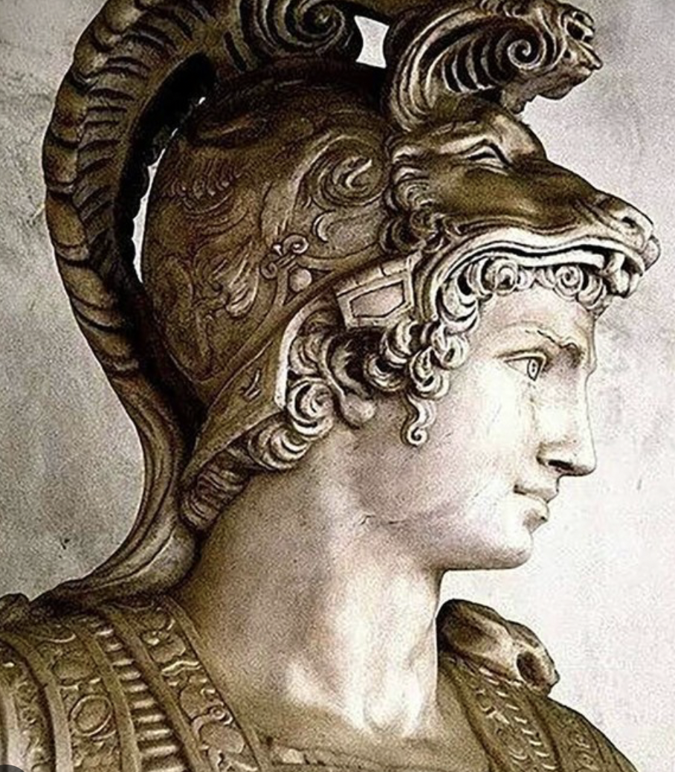
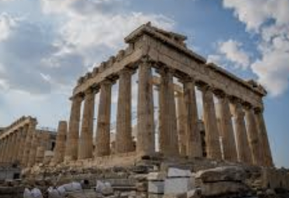
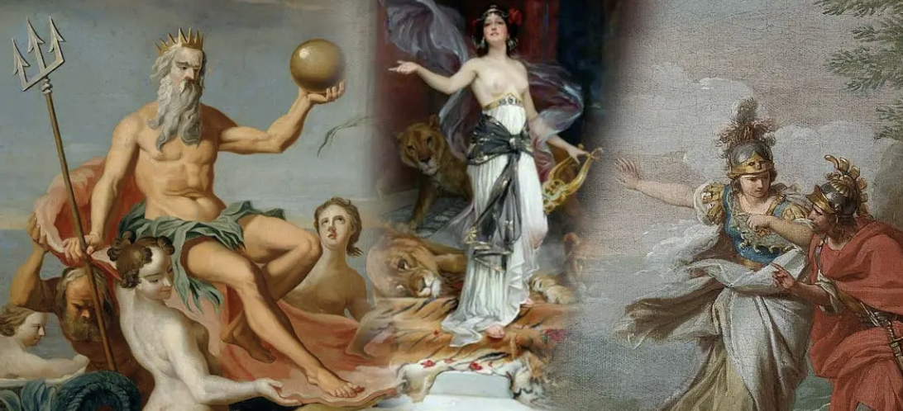
Ancient Greece
HISTORY KNOWLEDGE ORGANISER
ESSENTIAL VOCABULARY
civilisation | A human society with rules and a government.
City State | Small areas that Ancient Greece was divided into. Each with their own government, laws and army.
empire | A group of countries or states that are ruled by one ruler or country. .
legacies | Things that exist after someone dies or after a civilisation or event ends. .
democracy | A system where the citizens of a country or state are involved in how it is run.
myth | A story from ancient times about something that happened long ago tat some people believed to be true. .
Key Places
The Spartans were known for their strong army and ability to fight. In childhood, boys were trained to be warriors. Girls were taught academic subjects and how to fight. The Athenians were known for their cultural developments and learning. Girls did not go to school but many were taught how to look after the home and family.
Key People
Alexander the Great Socrates Plato Aristotle Homer
Gods and Goddesses
The ancient Greeks believed in many different gods and goddesses. Each god/goddess represented a certain aspect of humanity and each was responsible for certain parts of life too. • Festivals were held to celebrate the gods and goddesses. • It is believed that the 12 most powerful gods lived on Mount Olympus. • Zeus was the most powerful of all the gods. He was god of the sky and the king of Mount Olympus.
Democracy
Ancient Athens is where democracy began in around 508 BC. Listening to the opinions of other people and debating issues was an important part of this system. After debating issues, the ancient Athenians would vote. At that time, the only people allowed to take part in democracy were adult males who were citizens of Athens.
The Olympics
The Olympics were firstheld in ancient Greece in 776 BC. This is one of the legacies of ancient Greece. Events included boxing, wrestling, running and chariot racing. Women were not allowed to compete in the Olympics. This was because ancient Greek women were not treated as equals to men and had fewer freedoms.
‘As a family we live, love, learn and celebrate with Jesus.’

