Slide 1
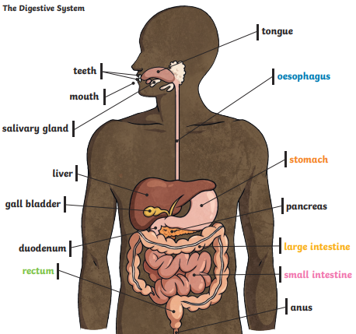
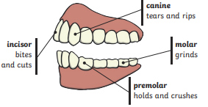
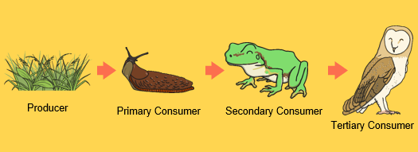
Animals inc. humans
SCIENCE KNOWLEDGE ORGANISER
ESSENTIAL VOCABULARY
Digest | Break down food so it can be used by the body.
Oesophagus | A muscular tube which moves from the mouth to the stomach.
Stomach | An organ in the digestive system where food is broken down with stomach acid and being churned around.
Small Intestine | Part of the intestine where nutrients are absorbed into the body.
Large Intestine | Part of the intestine where the water is absorbed from remaining food waste. Stools are formed in the large intestine.
Omnivore | An animal that eats plants and animals.
Herbivore | An animals that eats plants.
Carnivore | An animal that eats animals.
Prey | An animal that gets hunted and eaten by other animals.
Producer | A plant that produces its own food.
Predator | An animal that hurts and eats other animals.
Key Themes
Digestive system Teeth Food chains
Useful Diagrams
LINKS TO PREVIOUS LEARNING
identify and name a variety of common animals including fish, amphibians, reptiles, birds and mammals identify and name a variety of common animals that are carnivores, herbivores and omnivores describe and compare the structure of a variety of common animals (fish, amphibians, reptiles, birds and mammals, including pets) identify, name, draw and label the basic parts of the human body and say which part of the body is associated with each sense. notice that animals, including humans, have offspring which grow into adults find out about and describe the basic needs of animals, including humans, for survival (water, food and air) describe the importance for humans of exercise, eating the right amounts of different types of food, and hygiene. identify that animals, including humans, need the right types and amount of nutrition, and that they cannot make their own food; they get nutrition from what they eat ▪ identify that humans and some other animals have skeletons and muscles for support, protection and movement.
Any Visual Representations
‘As a family we live, love, learn and celebrate with Jesus.’

